Slide 1



Empower Teams to Deal with Common Problems in Legacy Systems
The Ultimate Toolset for Tackling Legacy Code Base Challenges

Slide 2

Empower Teams to Deal with Common Problems in Legacy Systems
Who am I ?
Vladimir Conev
Technical Team Lead @Scalefocus
https://twitter.com/vladimirconev
https://github.com/vladimirconev
conev.vladimir@gmail.com
vladimir.conev@scalefocus.com

Slide 3
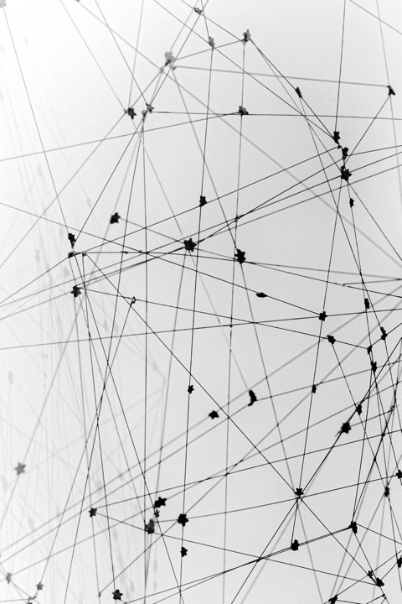

Empower Teams to Deal with Common Problems in Legacy Systems
Agenda
01 What is Legacy code systems?
02 Survival kit to regain control
03 Modernizing Legacy code base
04 QA session

Slide 4


Empower Teams to Deal with Common Problems in Legacy Systems
What is Legacy code system?
Wikipedia to the rescue:
In computing, a legacy system is an old method, technology, computer system, or application program, "of, relating to, or being a previous or outdated computer system," yet still in use. Often referencing a system as "legacy" means that it paved the way for the standards that would follow it. This can also imply that the system is out of date or in need of replacement.
Reference: https://en.wikipedia.org/wiki/Legacy_system

Slide 5
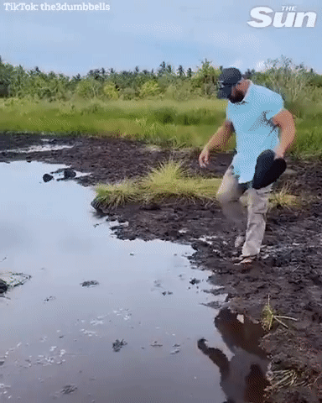
Empower Teams to Deal with Common Problems in Legacy Systems
Developers Diving into
company’s old code base
Reference:
https://twitter.com/kvncnls/status/1546836287340044290
5

Slide 6

Empower Teams to Deal with Common Problems in Legacy Systems
What is Legacy
code system?
Mission-critical systems that are STILL up and running
Grow rapidly over time
Tech stack is outdated
Long Release cycles
No documentation
Low test coverage
Accumulated technical debt
Development team cannot keep up with business requirements
Integration with third-party systems
Tight coupling
6

Slide 7


Empower Teams to Deal with Common Problems in Legacy Systems
What is a Legacy code system?
Good Product-market fit as it has managed to survive multiple iterations
Opportunity to learn and grow as a software engineer
Write and maintain manuals, How-to articles, and documentation
Mitigate Technical debt
Extract features as modules
Data migrations
Increase coverage
Here to stay as they are essential for the business

Slide 8
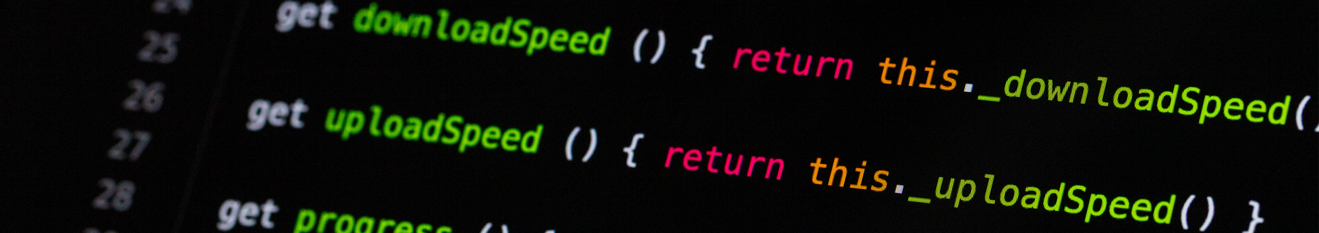
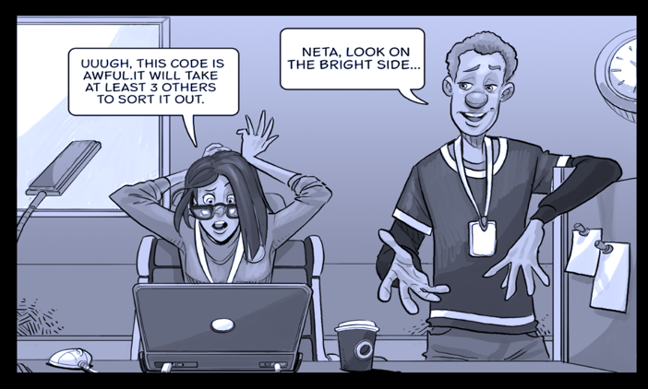
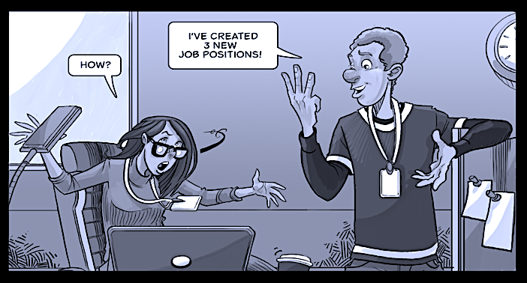
Empower Teams to Deal with Common Problems in Legacy Systems
What is a legacy code base?
Perception of complexity (notion of code quality) is related to:
Previous experience
Domain knowledge
Technology stack
Code being complex DOES NOT necessarily mean it is a mess

Slide 9

Empower Teams to Deal with Common Problems in Legacy Systems
Code base being a mess…
How to overcome this tricky situation ?
Brainstorming sessions might be quite helpful to create a rough drafts of unrefined ideas which later on can be converted in detailed actions plans on concrete improvements
It is essential to build up Quality Principles that your team will follow.
Try to enforce them by introducing https://www.archunit.org/ and https://github.com/google/error-prone.
Time Constraints might limit our actions and set up certain boundaries.
9
Notes:
.

Slide 10


Empower Teams to Deal with Common Problems in Legacy Systems
Survival kit to regain control
Architectural Decision Records (ADRs)
Obstacle: Lack of context
Dilemma: Keep the code as it is and work around it OR change it and take the risk of breaking something unexpectedly.
No magic stick to generate missing documentation, BUT there is a way to stop your code from bleeding.
Compact and traceable documentation of all important decisions made during the project realization
Timeline of decisions to create proper context and understand technical changes throughout the product lifecycle
Markdown (.md files) + Git to have lean documentation
ADRs usage in projects to get you inspired:
https://github.com/ministryofjustice/form-builder/tree/master/decisions
https://github.com/nicoespeon/abracadabra/tree/main/docs/adr
Reference: https://adr.github.io/ https://tangly-blog.blogspot.com/2018/07/architectural-decision-record-adr.html https://understandlegacycode.com/blog/7-techniques-to-regain-control-of-legacy/

Slide 11
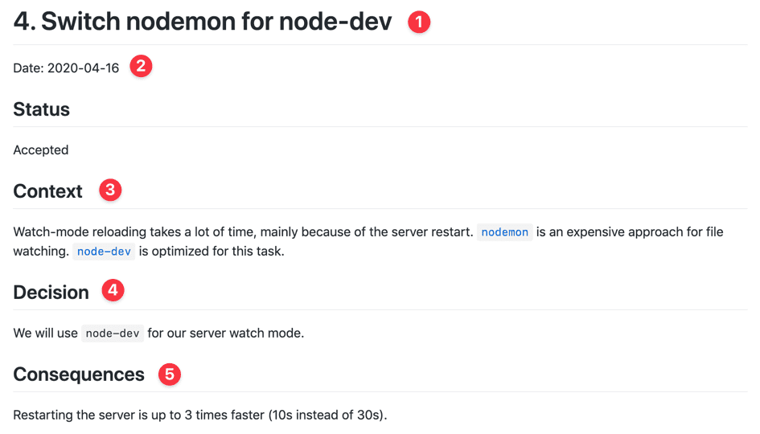
Empower Teams to Deal with Common Problems in Legacy Systems
Survival kit to regain control
1. Architectural Decision Records (ADRs)
11
Notes:
.

Slide 12
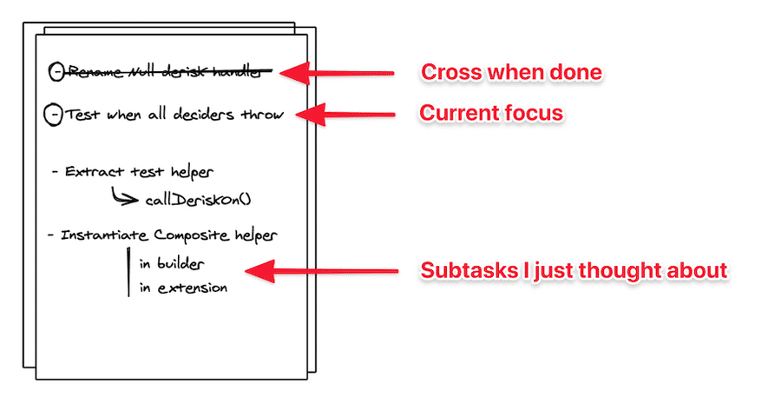
Empower Teams to Deal with Common Problems in Legacy Systems
Survival kit to regain
control
2. Brain dump
Obstacle: Stay focused and calm your mind as you’ll have so many ideas on how to change and improve the code base.
Write down a TO DO list and execute all tasks and subtasks.
12
Notes:
.

Slide 13
Empower Teams to Deal with Common Problems in Legacy Systems
Survival kit to regain
control
Drow the
Mikado Goal
Mikado Method
Workflow
Implement the goal/prerequisite naively
Are there any errors?
No
Does
the change make sence?
No
3. Mikado Method
Yes
Yes
Come up with immediate solutions to the errors
Commit your changes
Brain dump with process
Draw the solutions as new prerequisites
No
Is the Mikado Goal met?
Revert your changes!!!
Yes
Done!
Reference: https://victorrentea.ro/blog/exploratory-refactoring/
Select the next prerequisite to work with
13
Notes:
.

Slide 14
Empower Teams to Deal with Common Problems in Legacy Systems
Survival kit to regain
control
4. Hotspot analysis
The Eisenhower Decision Matrix
Best way to regain control of your legacy system is to improve it progressively and iteratively BUT where to start? How to find what matters?
Urgent
Not Urgent
Do
Do it now.
Important
Decide
Schedule a time
to do it
Static code analysis tools such as SonarQube https://www.sonarqube.org/ will notify of accumulated tech debt, code smells, and duplications.
Not Important
Delegate
Delete
Who can do it for you?
Eliminate it
14
Notes:
.

Slide 15
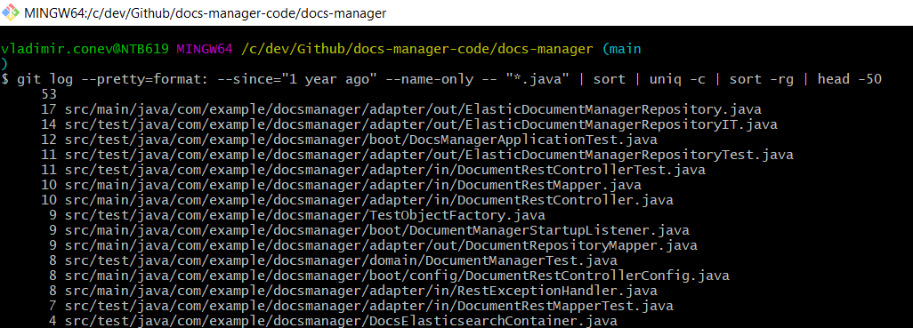
Empower Teams to Deal with Common Problems in Legacy Systems
Survival kit to regain control
4. Hotspot analysis
$git log --pretty=format: --since="1 year ago" --name-only -- "*.java" | sort | uniq -c | sort -rg | head -50
Reference: https://medium.com/@iqra.amjad128/eisenhower-matrix-da6544ad6788
15
Notes:
.

Slide 16
Empower Teams to Deal with Common Problems in Legacy Systems
Survival kit to regain control
5. Approval testing
3 steps process:
01
02
03
Generate an output you can snapshot
Snapshot is a return value
Use test coverage to find all valid inputs
Detect code snippets that are not covered by tests and modify input parameters to cover multiple different scenarios
Use mutations to verify your snapshot
Mutations stands for introducing bugs in your code deliberately so you can check a test is failing (comment out a line of code is the straight way to introduce a mutation) . can check the following mutation testing tool https://pitest.org/
You can’t keep these tests around, BUT this will allow you to refactor code faster and safer.
16
Notes:
.

Slide 17
Empower Teams to Deal with Common Problems in Legacy Systems
Modernizing legacy code base
Facade (structural design pattern)
Encapsulates a complex subsystem behind a simple interface. It allows us to hide much of the complexity and makes the subsystem easy to use.
Common use cases:
1. Decoupling Application code from a third-party library
Application
Third-party library
Application
Third-party library
Class1
Class1
Class1
Class1
Facade1
Class2
Class2
Reference: https://www.baeldung.com/java-facade-pattern https://levelup.gitconnected.com/3-main-use-cases-of-the-facade-design-pattern-in-enterprise-applications-aa9b290adac6
17
Notes:
.

Slide 18
Empower Teams to Deal with Common Problems in Legacy Systems
Modernizing legacy code base
Facade
2. Reusing legacy code in New application
Avoid tight coupling to legacy code. Devs can expose the legacy application functionality through a set of facades.
New code
Legacy code
New code
Legacy code
Class2
Class2
Class1
Class1
Facade1
Class1
Class1
Class2
Class2
Facade2
Class3
Class3
Reference: https://www.baeldung.com/java-facade-pattern https://levelup.gitconnected.com/3-main-use-cases-of-the-facade-design-pattern-in-enterprise-applications-aa9b290adac6
18
Notes:
.

Slide 19
Empower Teams to Deal with Common Problems in Legacy Systems
Modernizing legacy code base
Facade
3. Fixing violations of the Interface Segregation principle
Clients should not be forced to depend upon interfaces that they do not use.
Aplication
Aplication
Client1
Client1
Facade1
Complex
class
Complex
class
Cllient2
Client2
Facade2
Reference: https://www.baeldung.com/java-facade-pattern https://levelup.gitconnected.com/3-main-use-cases-of-the-facade-design-pattern-in-enterprise-applications-aa9b290adac6
19
Notes:
.

Slide 20

Empower Teams to Deal with Common Problems in Legacy Systems
Modernizing legacy code base
Strangler Fig pattern
Reference https://www.science.org/content/article/being-strangled-may-save-tree-s-life
20
Notes:
.

Slide 21
Empower Teams to Deal with Common Problems in Legacy Systems
Modernizing legacy code base
Strangler Fig pattern
Incrementally migrate a legacy system by gradually replacing specific pieces of functionality with new applications and services.
Minimize risk of the migration
Early migration
Later migration
Migration complete
Strangler Facade
Strangler Facade
Modern
Legacy
Modern
Legacy
Modern
Reference: https://docs.microsoft.com/en-us/azure/architecture/patterns/strangler-fig https://paulhammant.com/2013/07/14/legacy-application-strangulation-case-studies/ https://martinfowler.com/bliki/StranglerFigApplication.html
21
Notes:
.

Slide 22
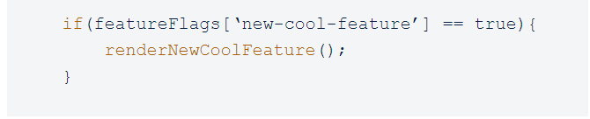
Empower Teams to Deal with Common Problems in Legacy Systems
Modernizing legacy code base
Feature flags
Turning ON/OFF specific functionality without new deployments
Allows us to introduce disruptive changes, validate them and minimize risk as at any point we can switch them off
Reference: https://www.atlassian.com/continuous-delivery/principles/feature-flags
22
Notes:
.

Slide 23
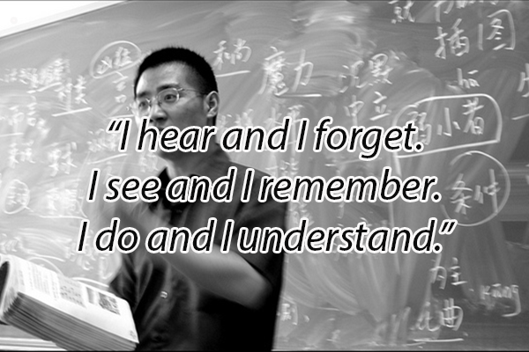
Empower Teams to Deal with Common Problems in Legacy Systems
Final words of wisdom
Break things to see how they (don’t) work
Advocate for iterative improvements following the scout rule Always leave the code better than you found it!
Lead by example
Create a Proof of concept and pitch it to respective decision makers and your team
Create How-to articles to spread knowledge
Document problems found and lines of investigation
Following these will eventually create a proper safety net and allow making changes without fear of breaking stuff.
Reference: https://www.open.edu/openlearn/education/12-famous-confucius-quotes-on-education-and-learning
23
Notes:
.

Slide 24
Empower Teams to Deal with Common Problems in Legacy Systems
Resources
Codurance Firechat
https://www.youtube.com/watch?v=k2ehbR0o-bM
https://www.youtube.com/watch?v=BKhDJCzaNes
Understanding Legacy Code
https://understandlegacycode.com/blog/7-techniques-to-regain-control-of-legacy/
Exploratory Refactoring by Victor Rentea
https://victorrentea.ro/blog/exploratory-refactoring/
Lead Dev Webinar
https://www.youtube.com/watch?v=_fTbjUfe2Cw
The Legacy of SoCraTes
https://www.youtube.com/c/TheLegacyofSoCraTes/featured
24
Notes:
.

Slide 25
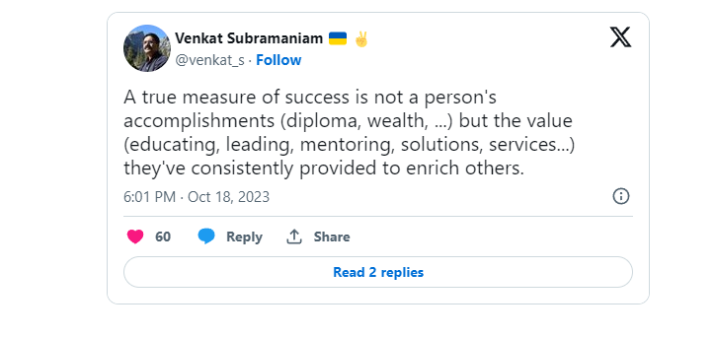
Empower Teams to Deal with Common Problems in Legacy Systems
https://twitter.com/venkat_s/status/1714672942490202255

Slide 26

Thanks for coming!
Looking forward to your Questions and discussing further.
www.scalefocus.com

